Slide 1

VeggieRx and CCDPH Partnership
Notes:
What it is we are doing here?
What should we name this partnership (per Lena)?

Slide 2
Welcome
Notes:
Welcome all to the meeting. Ice breaker.

Slide 3
Desired Outcomes
Define our partnership
Familiarize group with health atlas
Gather feedback on the health atlas
Identify next steps
Notes:
We have four desired outcomes for today’s talk:
Work collectively to define the character of our public health and food access-related partnership. We will explore what it means to be a citizen scientist. What it means to do epidemiological work within the context of this group.
Alfreda and Scott will introduce and familiarize group with the suburban Cook County health atlas. In addition to discussing its components, the group will also engage in an interactive tour of the atlas based on a theme of your selection.
(3) During and after this tour, we will gather your feedback concerning the function, design and usability of the atlas.
(4) We will revisit our understanding of this partnership, what we hope to achieve and identify next steps.

Slide 4
GROWING OUR PARTNERSHIP
OBJECTIVES
?
EPIDEMIOLOGY
?
Work ass a group to identify shared concerns, capabilities, objectives and responsibilities.
CITIZEN SCIENCE
?
PUBLIC HEALTH
Idea 1
Idea 2
Idea 3
FOOD ACCESS
?
?
Notes:
Take turns completing the information in this slide. What are the concerns of VeggieRx, others.

Slide 5

HEALTH ATLAS INDICATOR CATEGORIES
The health atlas will make available tools to explore and share public health information about suburban Cook County. Indicators on the health atlas will be organized into six information categories.
HEALTH OUTCOMES
DEMOGRAPHICS
Consequences, complications and other outcomes that result from disease (e.g., injury, hospitalization, death).
Population characteristics including community size, composition and structure (e.g., population, age, gender, race/ethnicity, migration).
HEALTH BEHAVIORS
?
SOCIOECONOMIC
The platform integrates several types of data
Individual activities that influence health (e.g., alcohol, drug and tobacco use; diet, physical activity, sleep).
Social and economic factors that can affect health (e.g., income, employment, education, segregation).
HEALTH CARE
PHYSICAL ENVIRONMENT
Systems and services for administering care (e.g., health screenings; primary, prenatal and dental care; clinics, hospitals, FQHCs).
Characteristics of the places where individuals where individuals live, learn, work, and play (e.g., parks, housing, air quality, water quality and transportation)
Notes:
What is the health atlas?
The health atlas is designed to help CCDPH work toward achieving health equity for all people and communities of suburban Cook County. Our Epidemiology unit focuses on public health planning, promotion and prevention. Part of this involves advocating for and working with community stakeholders to assure the natural environmental and social conditions necessary to advance physical, mental and social well-being.
several quality of life and risk indices related to public health that combine indicators across the six categories (e.g., social vulnerability index, index of concentration of extremes, neighborhood deprivation).

Slide 6


CCDPH PUBLIC HEALTH DATA SHARING ECOSYSTEM
The atlas will be an important component of CCDPH’s broader, multi-platform public health awareness,
data and code sharing ecosystem.
CCDPH STORYMAPS, DASHBOARDS AND REPORTS
SUBURBAN COOK COUNTY HEALTH ATLAS
Comprehensive, online health indicator data exploration and visualization tools designed for the broadest range of users
Immersive, topic-specific public health information presented using a combination of multimedia content including text and interactive maps
CCDPH GITHUB REPOSITORIES
CCDPH DATA REQUESTS
Delimited datasets, geographic feature layers and associated programming code made available for expert users
Online forms for partner agencies, researchers, community groups and the general public to request custom CCDPH datasets.
Notes:
The Cook County Department of Public Health’s Epidemiology Unit is leading an effort to design and deploy an online health atlas for suburban Cook County. We envision the atlas to be a platform for sharing a wealth of information to improve public health awareness and individual, agency decision-making.

Slide 7
HEALTH ATLAS INDICATOR SUB-CATEGORIES
The six primary categories will be further broken down into several subcategories.
HEALTH OUTCOMES
PHYSICAL ENVIRONMENT
HEALTH BEHAVIORS
SOCIOECONOMIC
Community safety
Food access
Housing
Transportation
Pollution exposure
Environmental risk
Chronic disease
Infectious disease
Injury and violence
Maternal & child
Alcohol & drug use
Tobacco use
Diet & exercise
Sexual activity
HEALTH CARE
DEMOGRAPHICS
Income
Education
Employment & occupation
Public assistance
Population age
Sex & gender
Race, & ethnicity
Household structure
Language
Migration status
Access to care
Quality of care
Facility utilization

Slide 8
health atlas FIRST YEAR DATA RELEASE TIMELINE
The atlas will be continually updated with the latest public health information for suburban Cook County. The rollout of the data over the first year will proceed in four phases. With each phase, the Epi Unit will reach out to other CCDPH units, the county and community-based contacts for data requests and feedback.
01
02
03
04
PHASE ONE
PHASE TWO
PHASE THREE
PHASE FOUR
Select indicators from CCDPH’s latest Community Health Status Assessment; Social Vulnerability; Communicable disease prevalence; Opioid deaths
2013 to 2020 birth and death rates; 2020 Youth Risk Behavioral Survey data; Environmental justice screening data
2018 to 2020 hospitalization inpatient and outpatient data
2022 Suburban Cook County Health Survey data; 2022 Youth Risk Behavioral Survey data
Notes:
Dates removed per Lena.

Slide 9
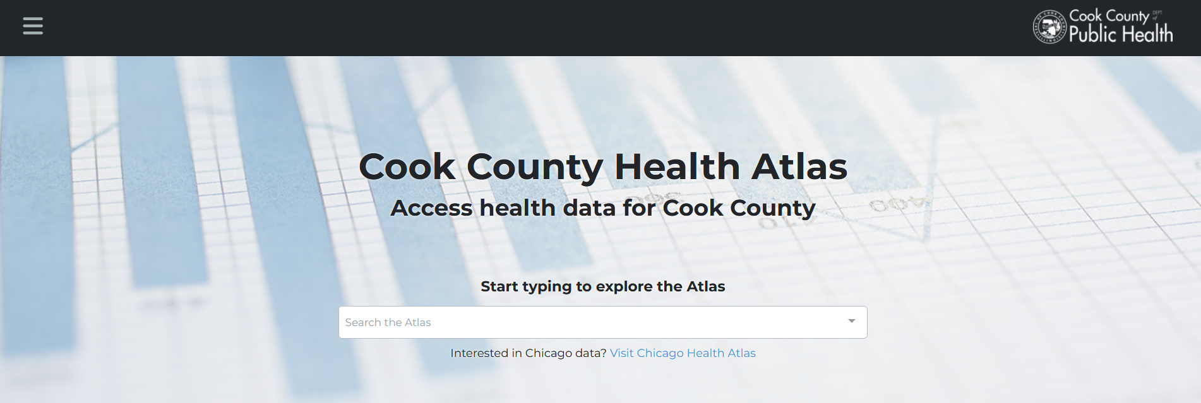
1
2
3
CHOOSE AN ACTIVITY THEME
HEALTH OUTCOMES
DEMOGRAPHICS
SOCIAL DETERMINANTS
Explore community patterns of disease and mortality
Explore neighborhood population characteristics including age, race and ethnicity
Explore indicators of food access and social vulnerability

Slide 10



CO-DESIGNING PUBLIC HEALTH DATA ACCESS & AWARENESS
CCDPH aims to work with VeggieRx to co-design the platform to improve its functionality and usability
(e.g., adding and enriching datasets, tools and documentation)
What did you find interesting with the health atlas?
What did you find confusing about the health atlas?
What types of data or tools could inform VeggieRx programs?
How could CCDPH’s Epi Unit further assist VeggieRx with the atlas?
Notes:
1. interesting?

Slide 11

NEXT STEPS
Identify potential uses &
enhancements
1
Work together to identify ways in which VeggieRx could use and/or improve the health atlas.
2
Implement changes
If needed, upload, edit and/or enhance datasets, tools and documentation on the platform.
3
Formalize use cases
Develop strategies and/or workflows to help VeggieRx utilize enhancements to the health atlas.

